Slide 1

A FIRST-IN-CLASS TREATMENT FOR NEURODEGENERATION; RELAXIN

Slide 2
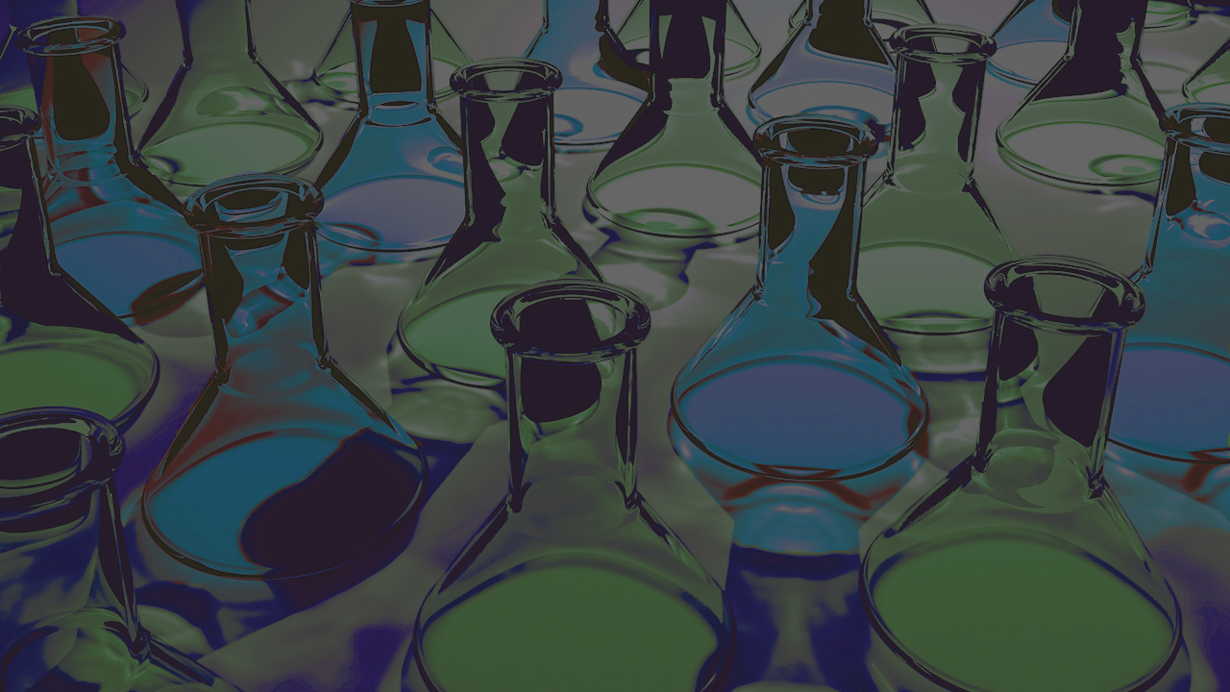
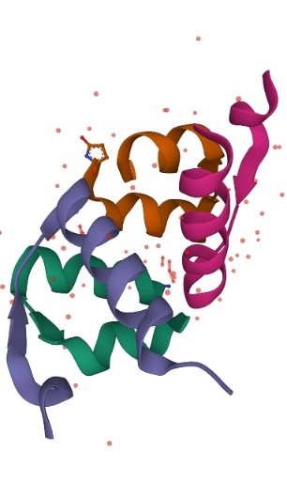
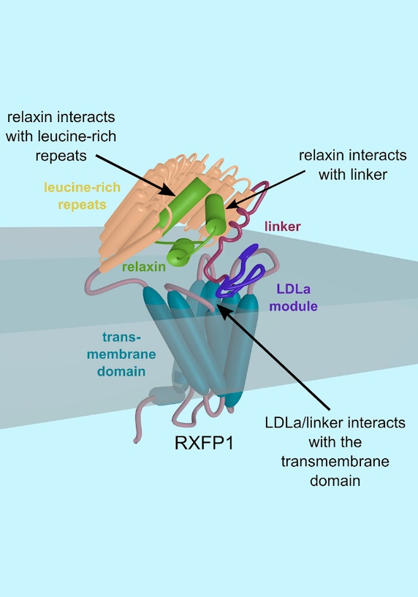

Relaxin Mode Of Action
Relaxin is an agonist of the glucocorticoid receptor, the relaxin family peptide receptor 1 and the peroxisome proliferator-activated receptor gamma.
These combined actions down regulate inflammation, modulate the immune system, repolarise microglia, regulate cytokines and chemokine receptor expression and increases Olig1 & 2.
These actions lead to enhanced neuroprotection and remyelination.
FIRST-IN-CLASS
2
Patented by BVBiomedical

Slide 3
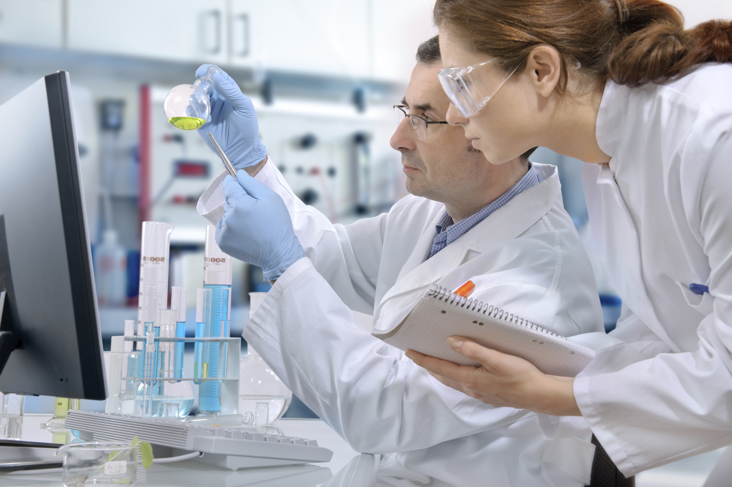

Relaxin’s Effect on Oligodendrocytes
OPC’s are the precursor cells necessary for remyelination. Low dose treatment with relaxin increased myelin production and OPC maturation and differentiation by 400X.
3

Slide 4
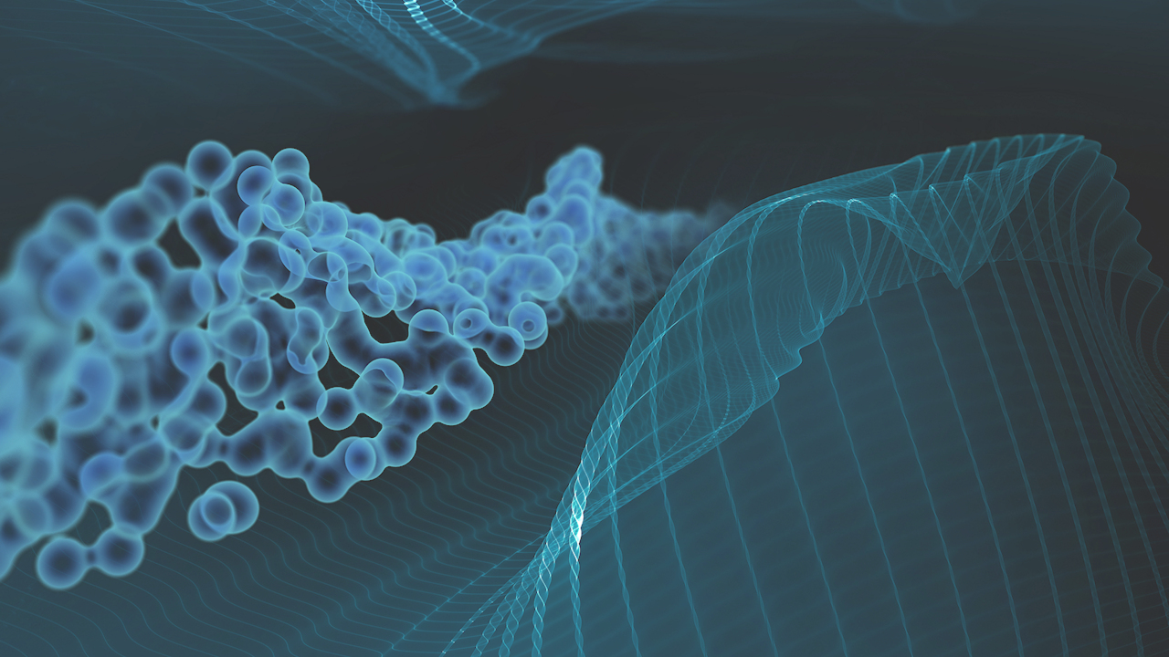
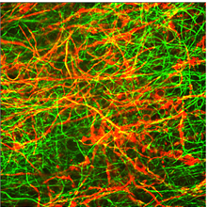
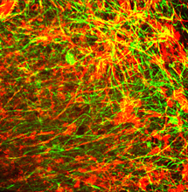
Relaxin Increases MBP Production
Newborn mouse cerebellar slices were placed in plate wells on mesh culture inserts.
Slices were demyelinated overnight with lysolecithin solution.
Slices were treated immersed in solutions containing 7.5ng/ml relaxin for 3 days.
Slices were fixed and stained for neurofilament and MBP.
6 slices per well, 3 repeats.
Neurofilament (green)
MBP (red)
PBS
7.5ng/ml Relaxin
Relaxin increased MBP production in treated slices compared to controls.
4

Slide 5


Relaxin Reduces Neuroinflammation in Zebra Fish
Lysolecithin causes an increase in neuroinflammatory cells in the brain.
Lysolecithin + relaxin shows a reduced number of neuroinflammatory cells compared to lysolecithin alone
Blue – Dapi
Green- Olig2
Red- Macrophage marker
Uninjected
Lysolectihin
Lysolectihin
+ Relaxin
5

Slide 6

Relaxins effect on Olig2 and ve branching in zebra fish model
Relaxin accelerates the rescues of cells from lysolecithin exposure.
Relaxin recovers the levels of branching to that of uninjected zebrafish.
Conclusions
Relaxin modulates the zebrafish immune response
Relaxin is 99.9% effective in rescuing cells from demyelination and promoting oligodendrocyte process regrowth with lysolecithin exposure.
6

Slide 7
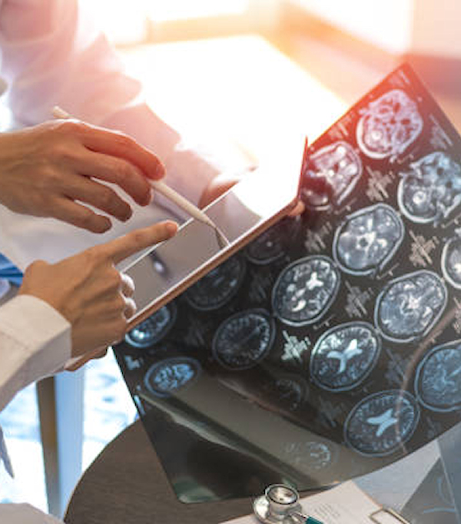

Experimental Autoimmune Encephalomyelitis (EAE)
EAE is characterized by inflammation, autoimmune response, demyelination and axonal loss. It is a common model to study multiple sclerosis.
Relaxin treatment was initiated in a murine model of EAE when hind limb paralysis was observed.
Treatment was terminated on day 22 after induction. The mice sacrificed and tissue and fluid samples collected for analysis.
Garvin, RA. Treatment with relaxin reduces disease symptoms and enhances neuroprotection and remyelination in murine experimental autoimmune encephalomyelitis. Ital J Anat Embry, Vol. 123, n. 1: 64-79, 2018.
7

Slide 8
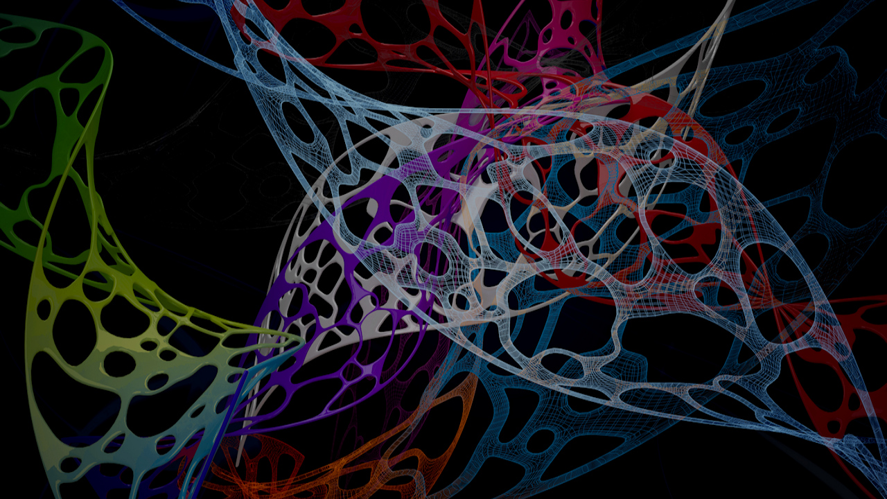
Relaxin improves clinical score in EAE
Animals receiving treatment (n=8) showed greater improvement in clinical scores (from average of 2.0 to <0.5) compared to the placebo treated group (n=8, from average of 2.0 to 1.5). Relaxin or PBS delivered via subcutaneous Alzet pump. ✳= p<0.05
Clinical Score of 0-5: 0 = normal; 1 = tail paralysis; 2 = tail paralysis and strong hind limb weakness; 3 = complete hind limb paralysis; 4 = hind limb and forelimb paralysis; and 5 = found dead.
*
*
*
*
8

Slide 9


Relaxin Down-Regulates Immunomodulators
RT-PCR analysis of spinal cords from EAE mice after treatment with Relaxin
Pro-inflammatory chemokine receptors were decreased in treated mice when compared to the placebo group.
Proinflammatory cytokines were decreased in the treated group relative to the placebo.
CCR2 (0.013 vs 0.043, p<0.05)*
CCR5 (0.0035 vs 0.0046, p<0.05)
CCR7 (0.0037 vs 0.014, p<0.05)
IL-6 (0.0004 vs 0.0009, p<0.05)
IL-17 (0.00024 vs 0.00007, p<0.05)
9

Slide 10
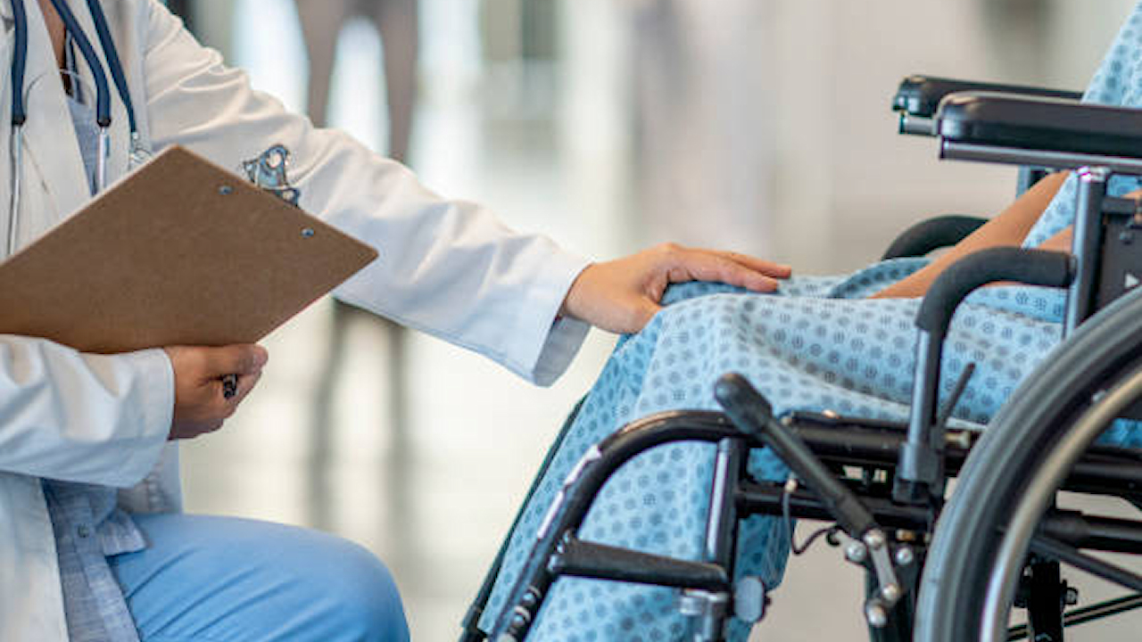
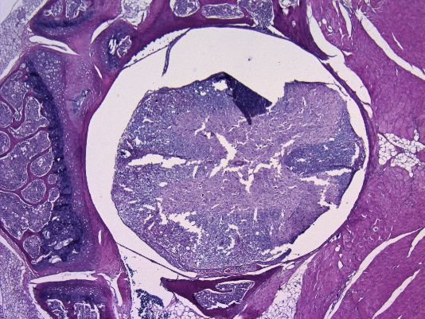
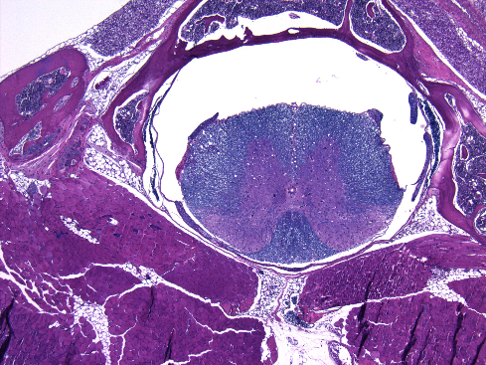
Relaxin Reduced Demyelination in EAE
Cross sections of spinal cord, myelin is stained blue.
The decrease in blue color indicates demyelination in untreated mice (A).
Whereas, treated mice (B) have more normal appearing myelin which stains an intense blue.
A
B
10

Slide 11

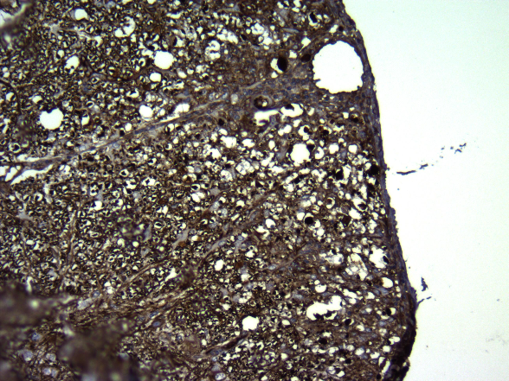
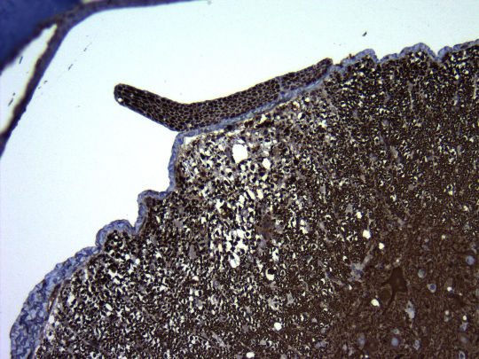
Relaxin Treatment Reduces The Loss of Neurons in EAE
A B
Staining indicates a greater loss of neurofilament in the spinal cords of untreated mice (A) compared to treated mice (B).
11

Slide 12
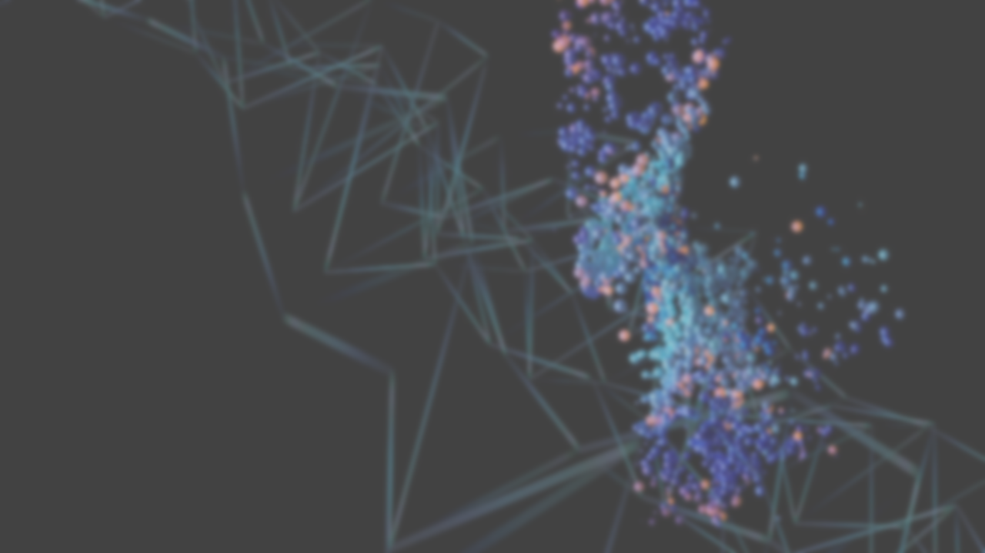
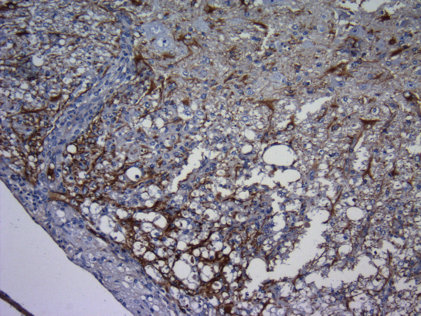
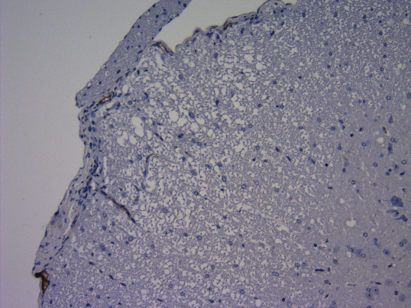
Staining for GFAP, a Biomarker of Gliosis
A B
The untreated sample (A) has large amounts of GFAP present indicating extensive gliosis.
The relaxin treated samples did not stain positively for GFAP
12

Slide 13
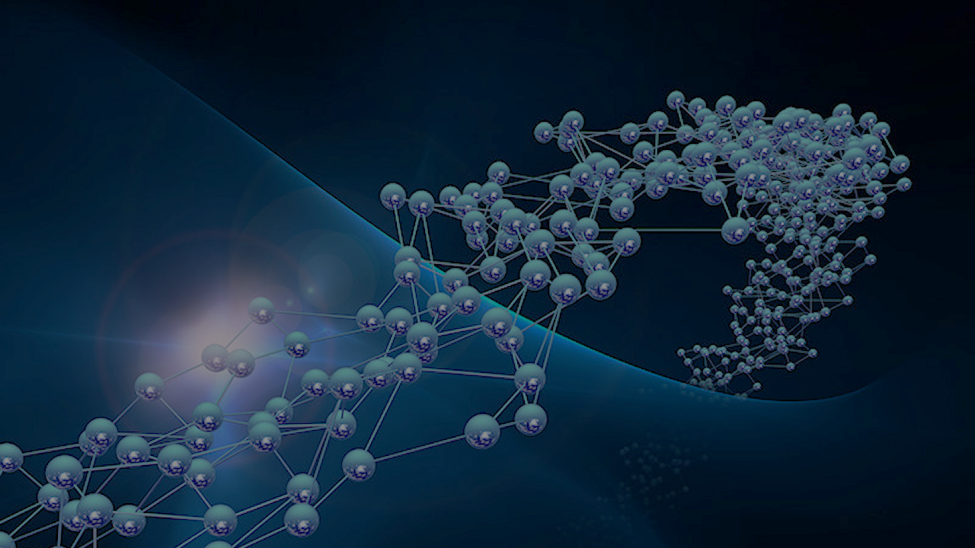
Relaxin as a Promoter of Remyelination
Spinal cord slices were stained for the presence of Olig1+ & 2+ cells.
Animals receiving relaxin had a 35% increase in Olig-2+ cells compared to controls, with over 71% of Olig2+ cells co-localized with Olig1+ cells, indicating remyelination.
In controls only 7% Olig1+ & 2+ cells co-localized.
Relaxin treatment promotes differentiation and maturation of OPC’s into mature myelin producing oligodendrocytes promoting remyelination.
13

Slide 14
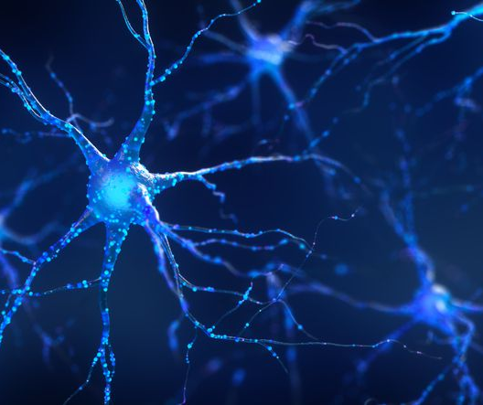
Motor Neuron Disease
MND is characterized by mitochondrial dysfunction, neuroinflammation and oxidative stress. Leading to loss of motor neuron function and death.
Relaxin Acts in the CNS
M. Bigazzi, 2013
DOI: 10.13128/IJAE-13903
Quintanilla RA, Utreras E, Cabezas-Opazo FA. Role of PPAR γ in the Differentiation and Function of Neurons. PPAR Res. 2014;2014:768594. doi: 10.1155/2014/768594. Epub 2014 Aug 26. PMID: 25246934; PMCID: PMC4160645.
14

Slide 15
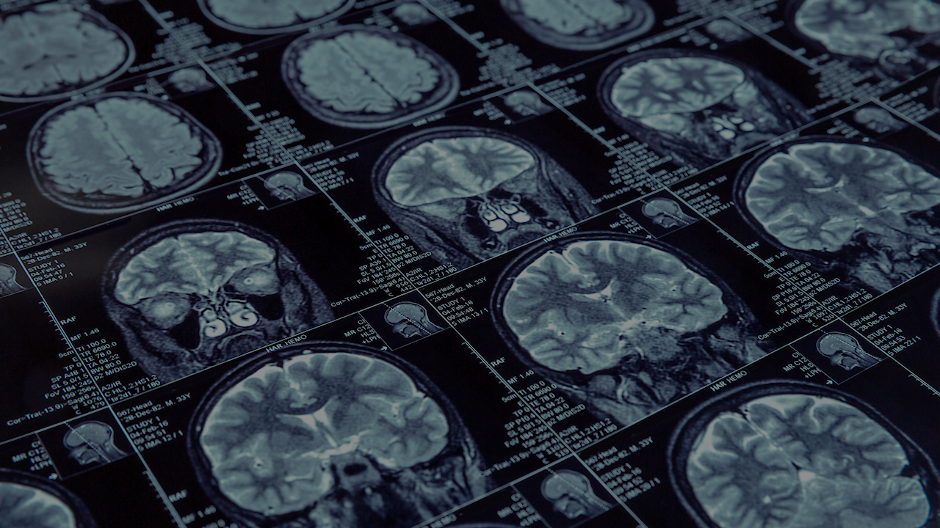

Parkinsons Disease
The pathognomonic hallmark of Parkiinsons Disease is the misfolding and propagation of the α-synuclein protein. An α-Synucleinopathy triggers neuroinflammation, oxidative stress, mitochondrial dysfunction, activated microglia, and synaptic dysfunction leading to neurodegeneration.
Pérez-Segura, I; et al. PPARs and Their Neuroprotective Effects in Parkinson’s Disease: A Novel Therapeutic Approach in α-Synucleinopathy? Int. J. Mol. Sci. 2023, 24, 3264.
15

Slide 16
Concussion
Traumatic Brain Injury
Concussions and other brain injuries trigger an Inflammatory response, chronic microglial activation, vasoconstriction and oxidative stress.
Relaxin shown to cross the BBB
SL Chan, 2013
DOI: 10.1096/fj.13-230797
Pearson A, et al, PPARγ activation ameliorates cognitive impairment and chronic microglial activation in the aftermath of r-mTBI. J Neuroinflammation. 2024 Aug 3;21(1):194. doi: 10.1186/s12974-024-03173-w.
16

Slide 17

PPARγ Mechanisms of Action
  Reduces inflammation by inhibiting pro-inflammatory pathways.
  Promotes the production of anti-inflammatory molecules and reduces the expression of inflammatory mediators.
  Inhibits chronic microglial activation.
  Protects against oxidative stress.
  Restore mitochondrial function.
  Is a potent vasodialator.
  Ameliorates congnitive impairment
  Is neuro-protective and promotes remyelination.
Villapol S. Roles of Peroxisome Proliferator-Activated Receptor Gamma on Brain and Peripheral Inflammation. Cellular and Molecular Neurobiology. 2018 Jan;38(1):121-132.

Slide 18


"In professional sport athletes are risking their brain health daily. There is a desperate need for a science based, practical solution to concussion recovery and ultimately prevention.
Athletes are now aware of the risks. Symptoms are mostly recognized and combined with changes in training methodology's and culture, concussion is responsibly being managed.
Unfortunately athletes will continue to injure their brains and there is still no science based treatment for traumatic brain injury to assist with prevention and cure.”
Dylan Hartley, former England Rugby Captain
BVBiomedical Ltd.
Magdalen Centre
Robert Robinson Avenue
The Oxford Science Park
Oxford, UK OX4 4GA
info@bvbiomed.com
Thank You
www.bvbiomed.com

